Slide 1
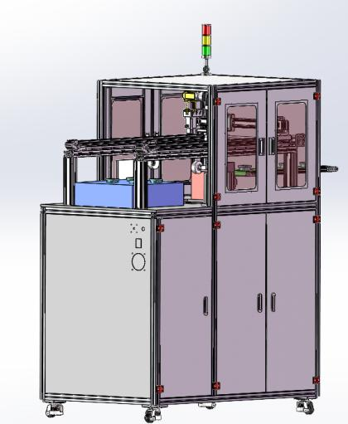
Equipment Introduction
Visual inspection equipment
Application scenario: Product visual inspection
Loading method: The injection machine feeds the material onto the designated flat loading platform.
Detection speed: Dependent on the feeding speed
Test item: Comprehensive appearance inspection of the product
Camera configuration: 4 cameras for inspection Detection light source *4

Slide 2
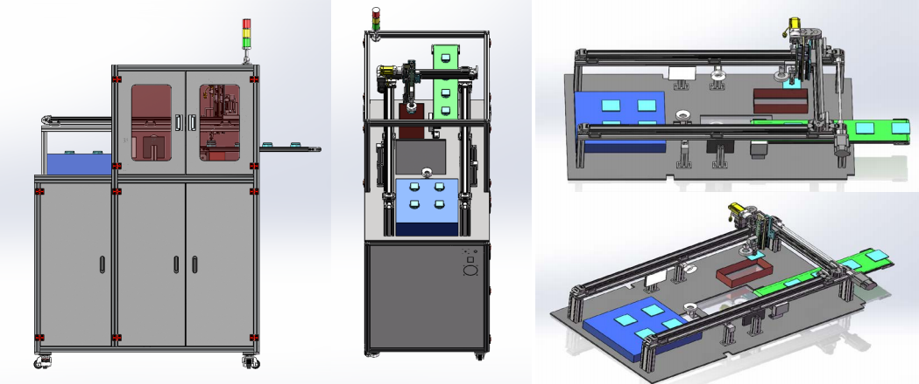
Equipment diagram

Slide 3
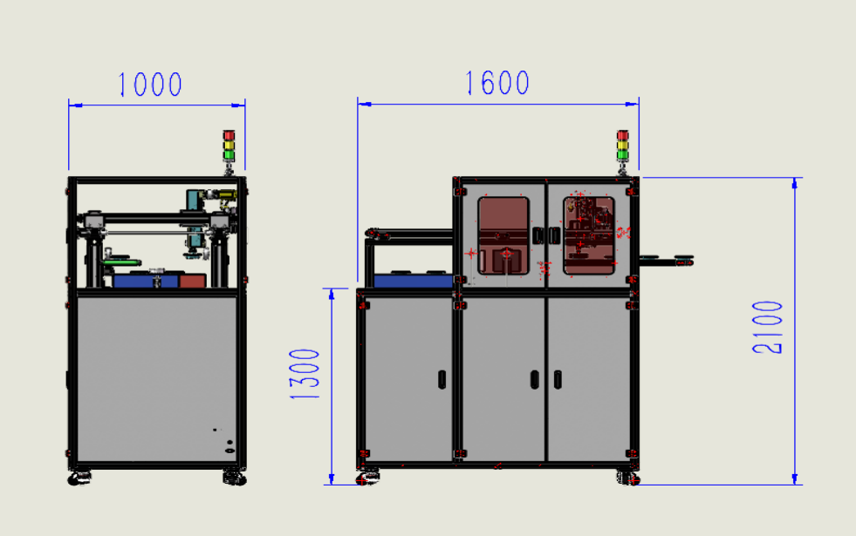
Equipment dimension drawing

Slide 4
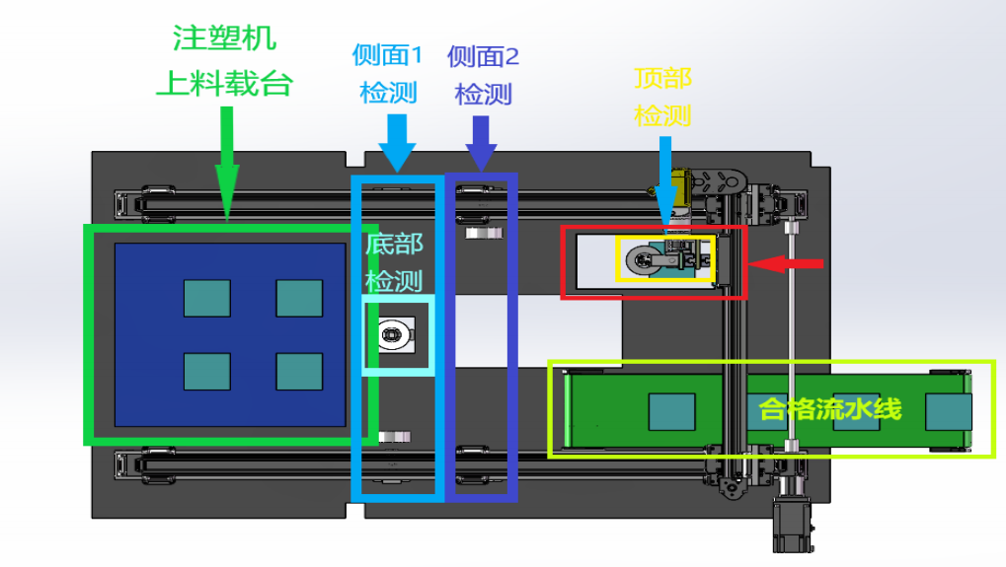

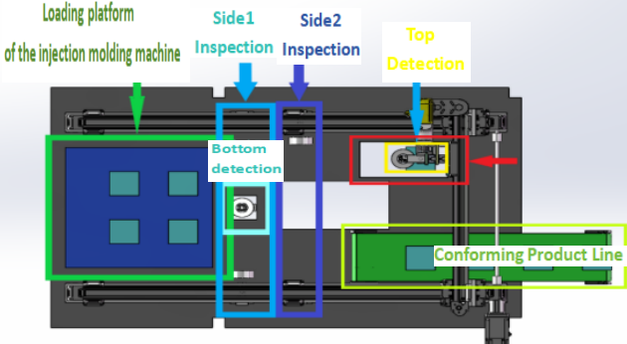
Equipment workstation introduction

